Slide 1
Division Meeting
SONOMA STATE UNIVERSITY | DIVISION OF STUDENT AFFAIRS
September 24, 2019
10:00-11:30am

Slide 2
OFFICE OF THE VICE PRESIDENT FOR STUDENT AFFAIRS
WM. GREGORY SAWYER, PH.D.
Vice President for Student Affairs
he/him/his
CONTACT INFO
sawyerg@sonoma.edu
707.664.2838
Student Center 3029
The Office of the Vice President serves as the administrative foundation and central location for the co-curricular programs, areas, and services of Student Affairs.

Slide 3
OFFICE OF THE VICE PRESIDENT FOR STUDENT AFFAIRS
AGENDA
Welcome
Area Updates
Closing Remarks
Oreo Cookie Tasting

Slide 4
Since the beginning of the year, how have you advanced a community of care…
For and/or with students
For and/or with your colleagues
For yourself

Slide 5
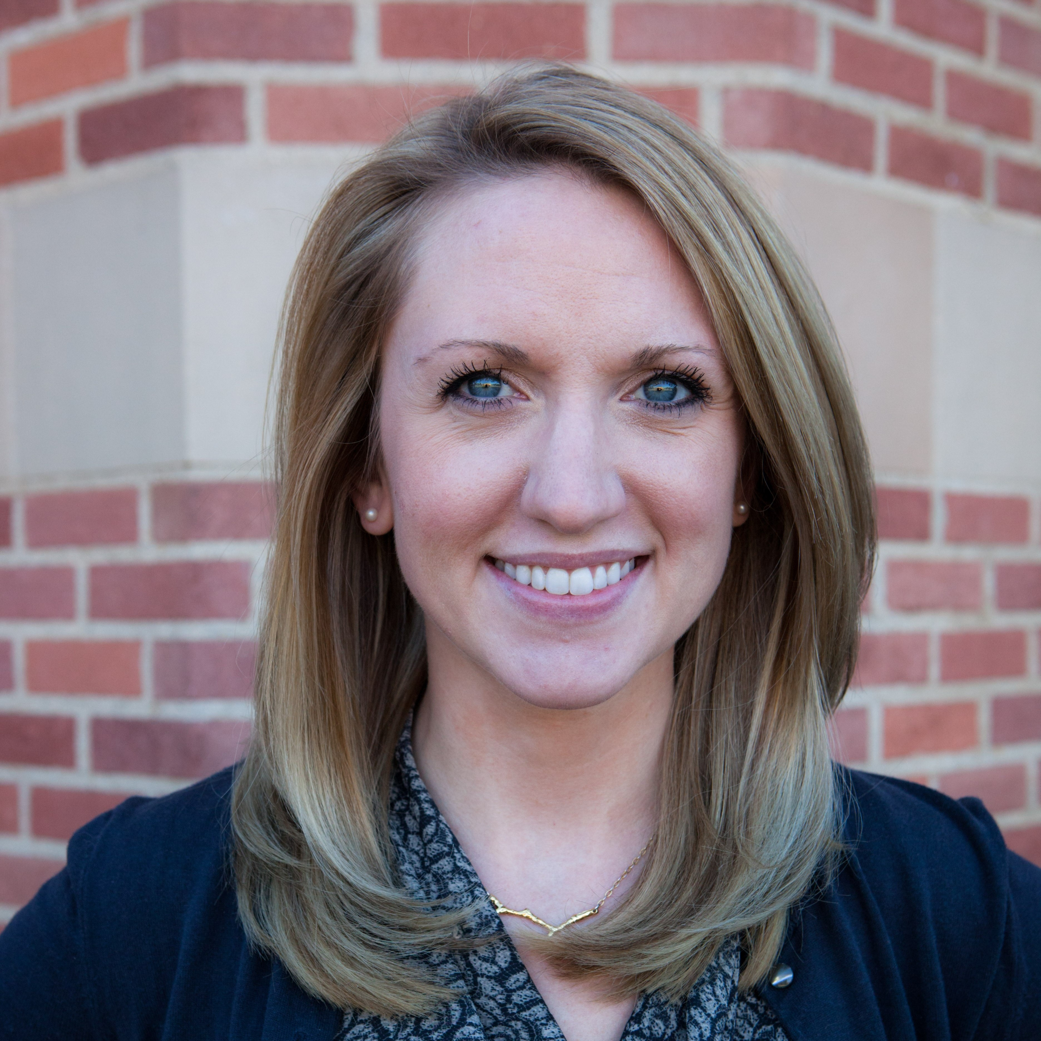
ASSESSMENT & STRATEGIC OPERATIONS
LAURA MONJE-PAULSON, PH.D.
Assistant Vice President for Student Affairs, Assessment & Strategic Operations
she/her/hers
CONTACT INFO
monjepau@sonoma.edu
707.664.3123
Student Center 3027
The purpose of ASO is to ensure structural integrity of the Division of Student Affairs’ assessment, strategic planning, communication, and professional development.

Slide 6
OFFICE OF THE VICE PRESIDENT FOR STUDENT AFFAIRS
UPDATES
Office Moves:
CAASE: Oct. 7-9, Schulz First Floor
CAPS Modulars: During Winter Break
Housing: October, Zinfandel
SSA: Oct. 4-6, Schulz First Floor
Testing Services: Summer 2019, Carson 60

Slide 7
OFFICE OF THE VICE PRESIDENT FOR STUDENT AFFAIRS
UPDATES (con’t)
Open Houses:
CAASE: November (tba)
Career Center: October 16, 3:30-5:30p, Int’l Hall
Disability Services for
Students: October or November (tba)
Pre-Collegiate Programs
Building Renaming: November 14 (tentative)
Student Success &
Advising: November (tba)

Slide 8
ASSESSMENT & STRATEGIC OPERATIONS
UPDATES
Communication and branding/strategic plan
University Marketing and Branding Initiative – Guest Speaker Paul Gullixson, Associate Vice President for Strategic Communications
Competencies Survey

Slide 9
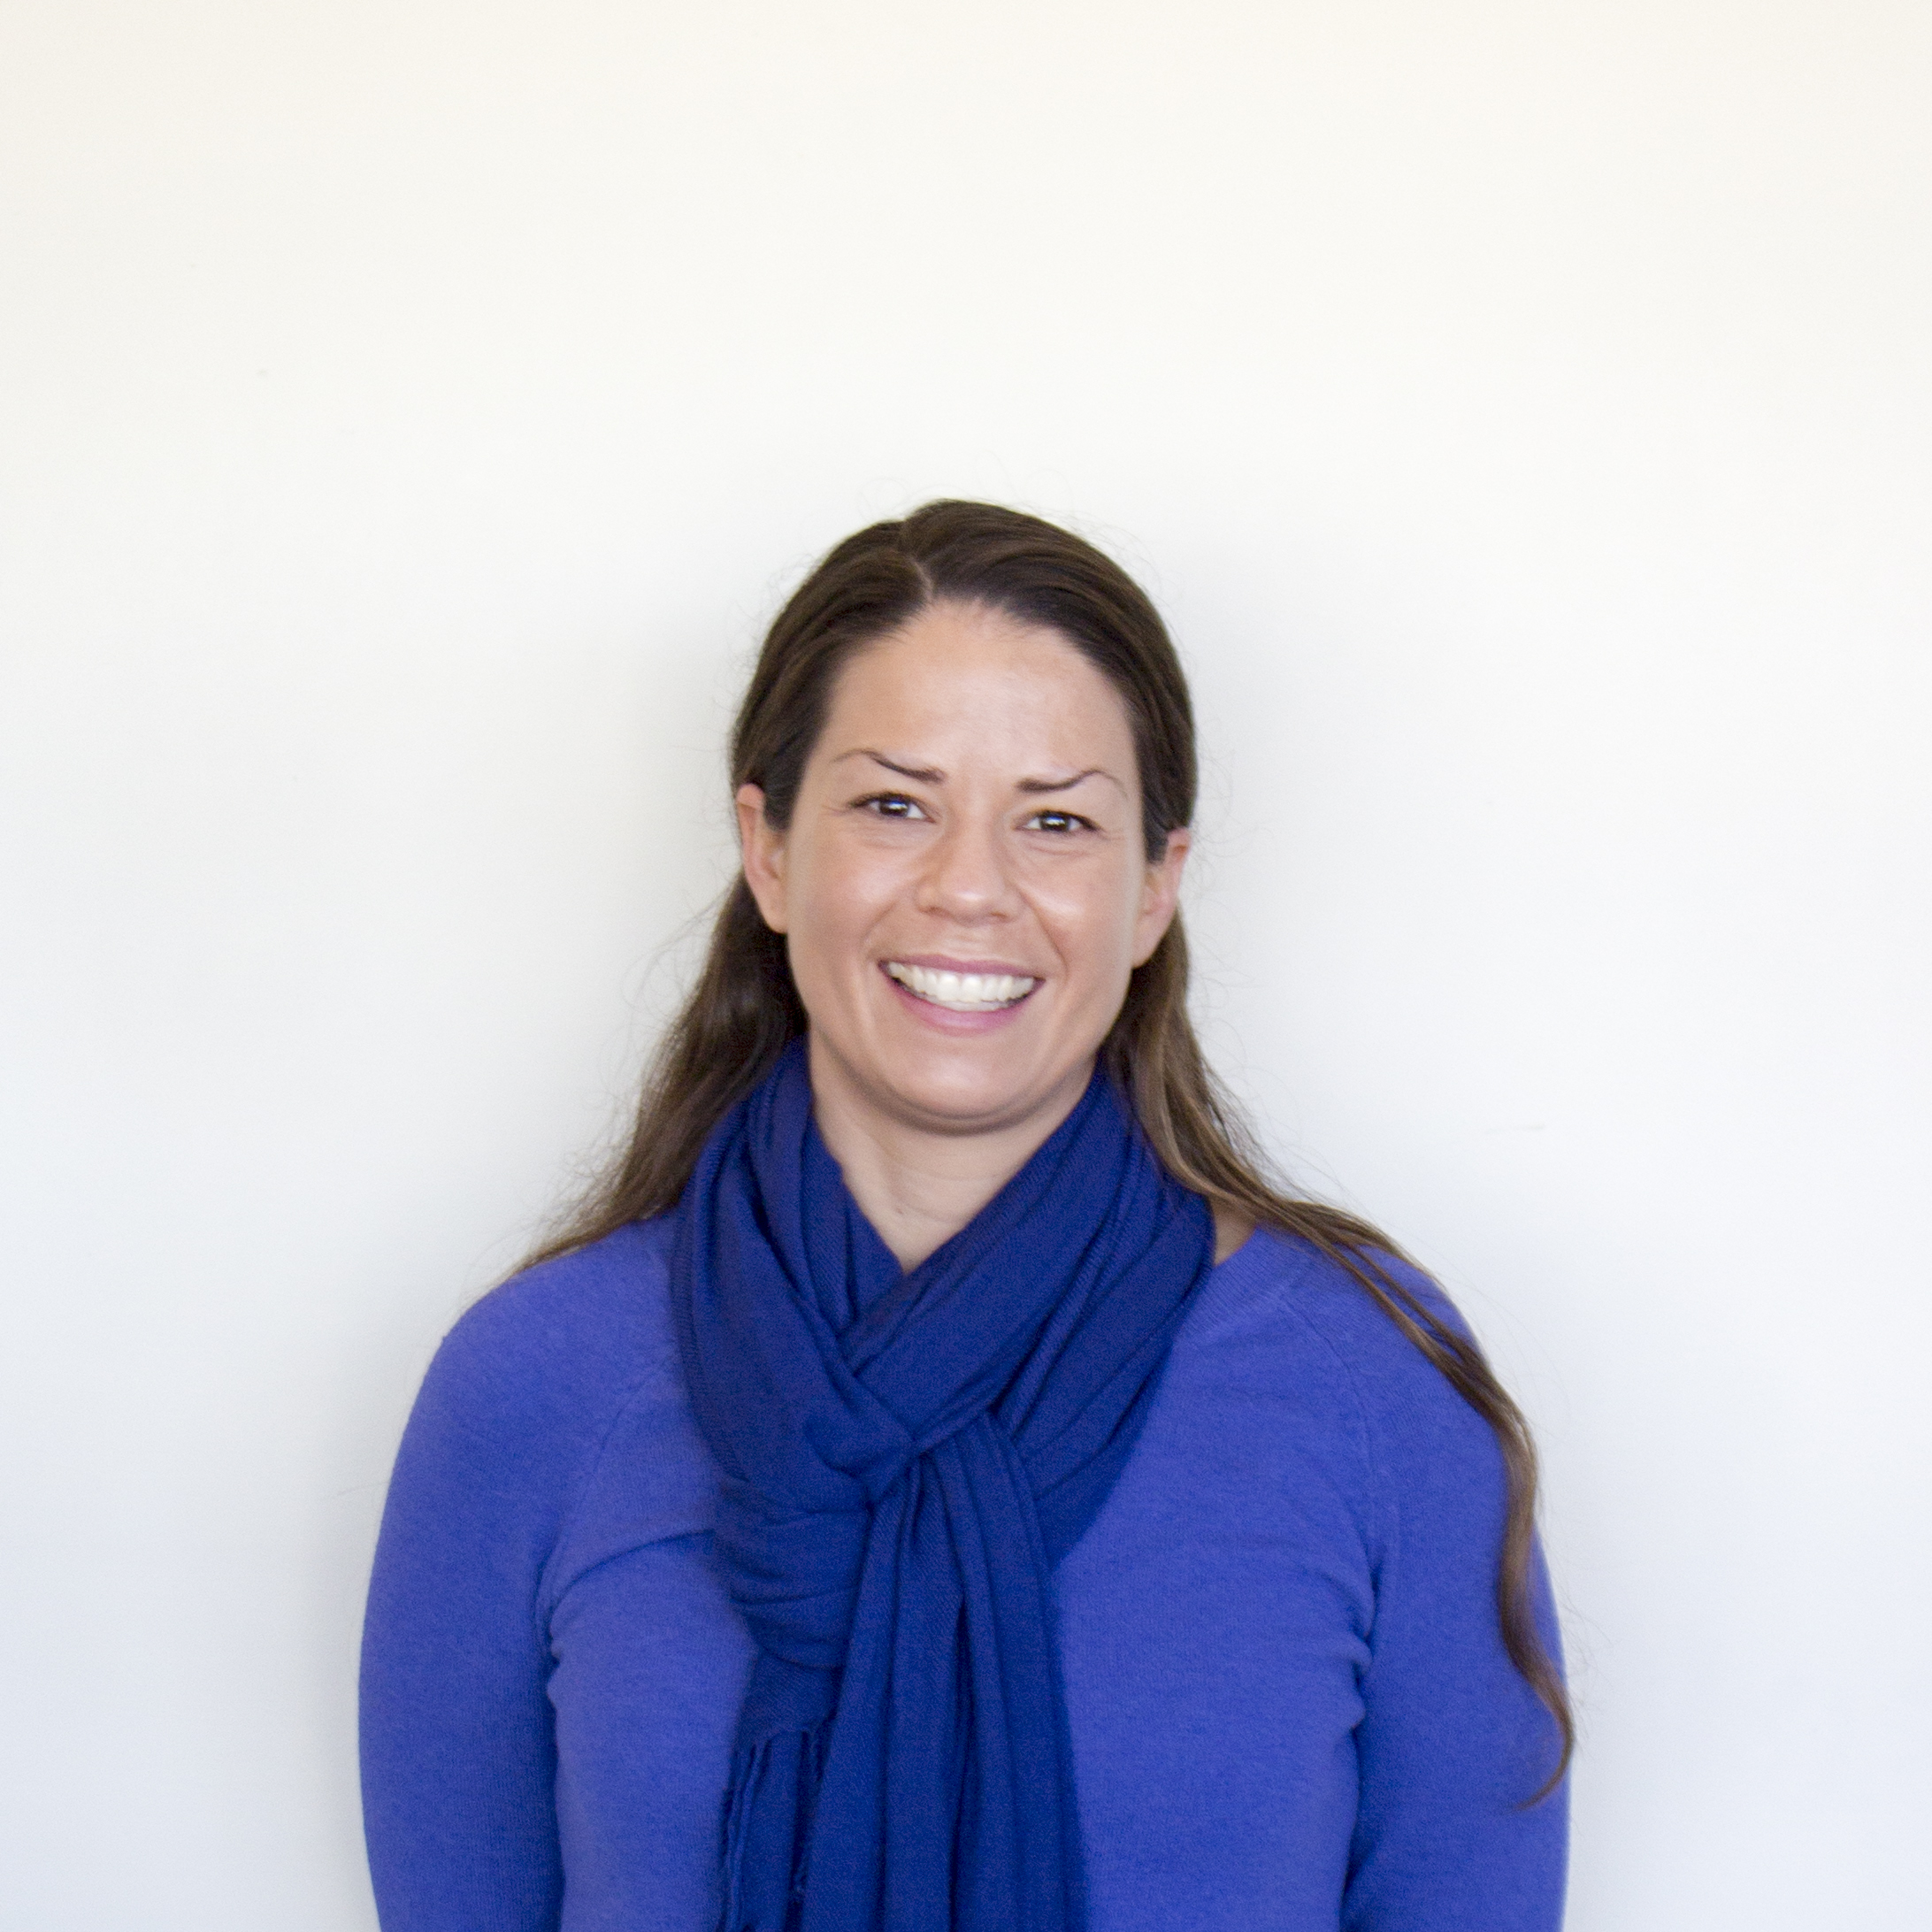
ADMINISTRATIVE & FINANCIAL PLANNING
ANNA REYNOLDS-SMITH, M.P.A.
Director
she/her/hers
CONTACT INFO
anna.reynolds@sonoma.edu
707.664.4206
Student Center 3028
The purpose of Administrative and Financial Planning is to manage the Division of Student Affairs’ administrative processes, fiscal resources, and personnel resources.

Slide 10
ADMINISTRATIVE & FINANCIAL PLANNING
UPDATES
Administrative Updates:
Hospitality Policy Revision Update
Budget Updates:
Campus Budget Presentation
19/20 GI 2025 Funding = 1,045,000
Enrollment Update

Slide 11
ADMINISTRATIVE & FINANCIAL PLANNING
UPDATES-Con’t
Budget Updates (con’t):
5-yr Business Plans
Fall Budget Forum hosted by PBAC
October 29, 9-10:30am, SC Ballroom A

Slide 12
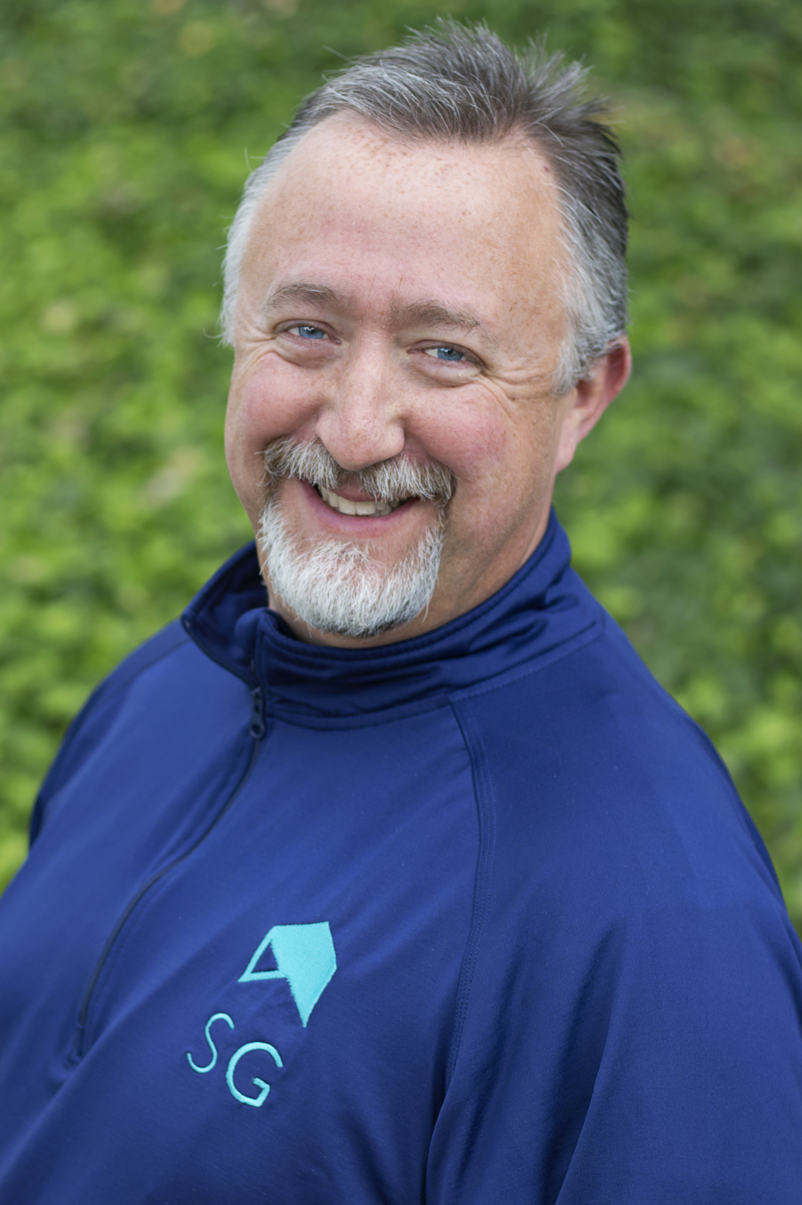
ASSOCIATED STUDENTS
ERIK DICKSON, M.A.
Executive Director
he/him/his
CONTACT INFO
erik.dickson@sonoma.edu
707.664.2669
Student Center, 2nd floor
As a student-run, student-led campus auxiliary, we serve as the official voice and advocate for the students and provide students with a variety of programs and services.

Slide 13
UPDATES
ASSOCIATED STUDENTS
CalFresh Outreach Day –
Mon. Oct. 7, 11a-2p, Schulz 2010
Basic Needs
AS Udates

Slide 14
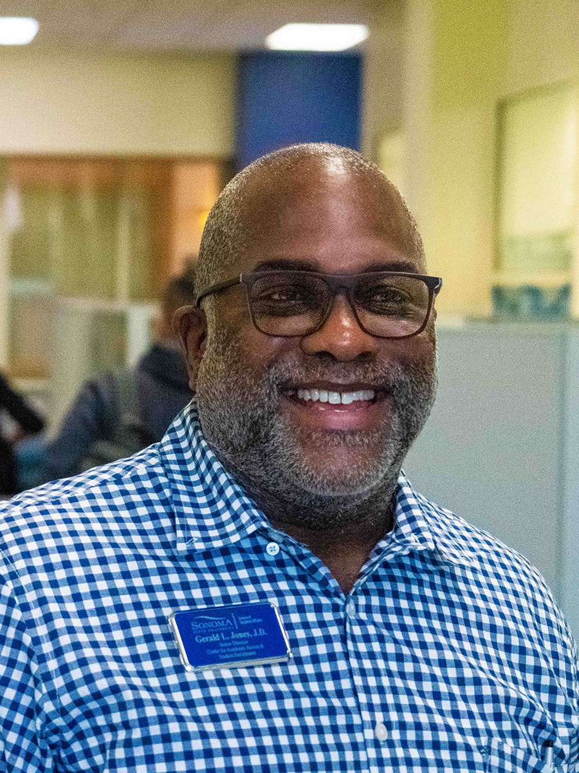
CENTER FOR ACADEMIC ACCESS & STUDENT ENRICHMENT
GERALD L. JONES, J.D.
Senior Director
he/him/his
CONTACT INFO
gerald.jones@sonoma.edu
707.664.4201
Salazar 1041-A
The purpose of CAASE is to provide SSU’s under-represented and underserved students with resources to persist and graduate.

Slide 15
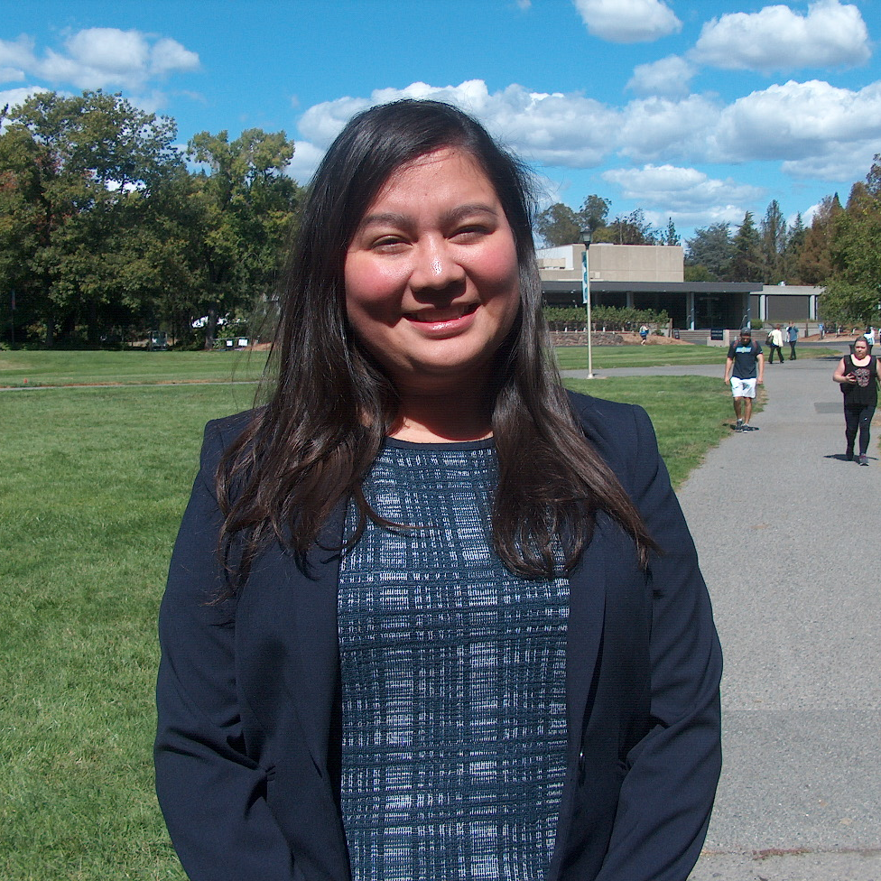
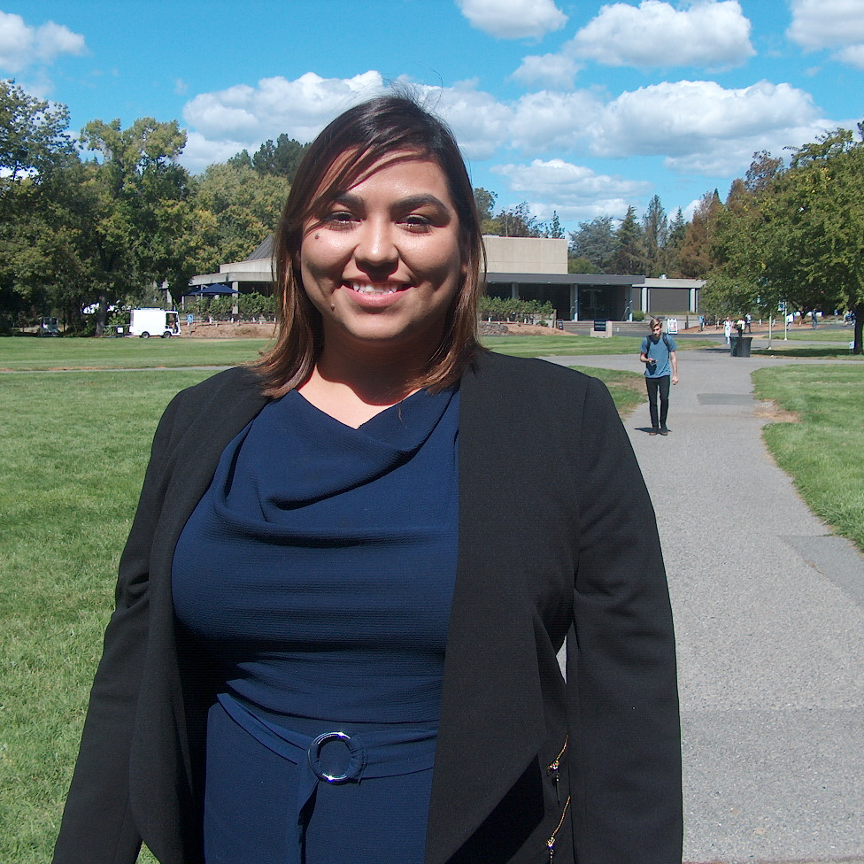
CENTER FOR ACADEMIC ACCESS & STUDENT ENRICHMENT
New Employees
Gaby Garcia
CHIRLA Law Clerk
Lynnette Torres
CHIRLA Law Clerk

Slide 16
CENTER FOR ACADEMIC ACCESS AND STUDENT ENRICHMENT
UPDATES
Legal Services in DREAM Center
Project Rebound

Slide 17
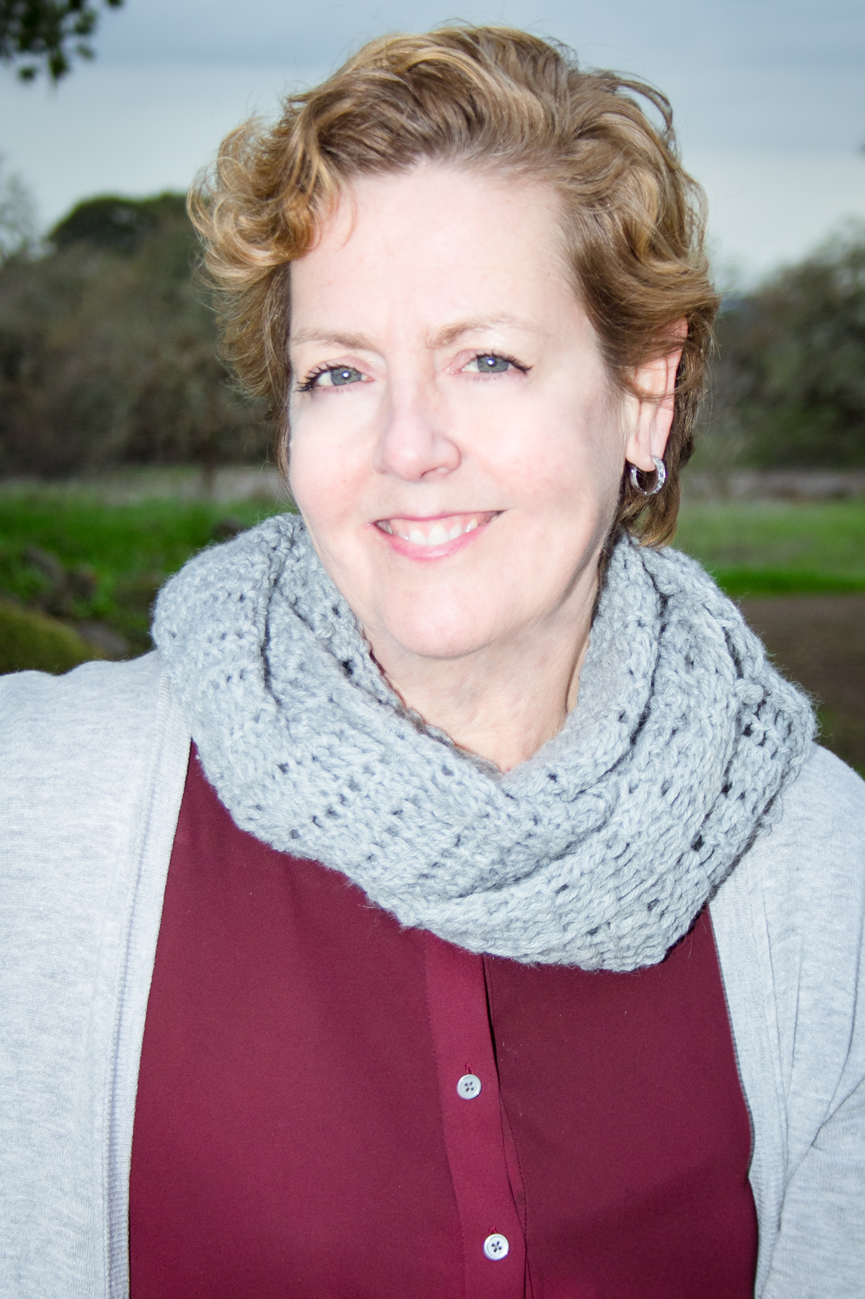
PRE-COLLEGIATE PROGRAMS
SUSAN WANDLING, M.A.
Senior Director
she/her/hers
CONTACT INFO
susan.wandling@sonoma.edu
707.664.3122
Pre-Collegiate Programs Building
The purpose of Pre-Collegiate Programs is to provide information and services to families in SSU’s local communities to prepare K-12 students for college success.

Slide 18
PRE-COLLEGIATE PROGRAMS
UPDATES
UB Saturday Academy Starts Sept. 28
ATS STEM Days Start Sept. 28
PCP Open House – Nov. 14

Slide 19
STUDENT ENGAGEMENT
RYAN JASEN HENNE, PH.D.
Dean of Students
he/him/his
CONTACT INFO
henne@sonoma.edu
707.664.3078
Student Center 3020
The purpose of Student Engagement is to provide access and resources for self-advocacy, leadership cultivation, and transformative experiences to create a connected Sonoma State University community.

Slide 20
STUDENT ENGAGEMENT
New Employees
Hannah Thomas
Interim Leadership Programs Coordinator
Student Involvement
Jessica Zastrow
Fraternity and Sorority Advisor
Student Involvement

Slide 21
STUDENT ENGAGEMENT
UPDATES
Seawolf Leads Program

Slide 22
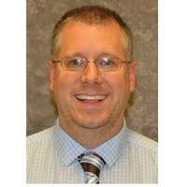
STUDENT SUCCESS & ADVISING
JAMIE ZAMJAHN, M.A.
Senior Director
he/him/his
CONTACT INFO
zamjahn@sonoma.edu
707.664.3079
Student Center 3024
The purpose of SSA is to help students successfully navigate their academic journey from their first class to graduation through innovative programs and initiatives, holistic academic advising, and the use of student success technology.

Slide 23
STUDENT SUCCESS AND ADVISING
UPDATES
Career Center Redesign
LoboConnect
Staff Search

Slide 24
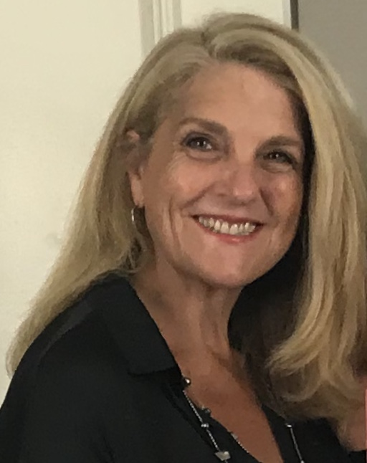
STUDENT HEALTH & WELLBEING
LAURA WILLIAMS, PSY.D.
Director, Counseling & Psychological Services
CONTACT INFO
willlaur@sonoma.edu
707.664.2153
Stevenson 1088
The purpose of Student Health and Wellbeing is to infuse health and wellness practices throughout the SSU community to support the personal wellbeing and academic success of all students.

Slide 25
STUDENT HEALTH AND WELLBEING
UPDATES
CAPS liaisons with campus departments
Modular Units
Self care in troubling times
Office moves: DSS (Schulz), Testing Services (Carson 60)

Slide 26
STUDENT HEALTH AND WELLBEING
New Employees
Jenna Baxter
Disability Management Advisor
Disability Services for Students
(Start Date: Oct. 7)

Slide 27
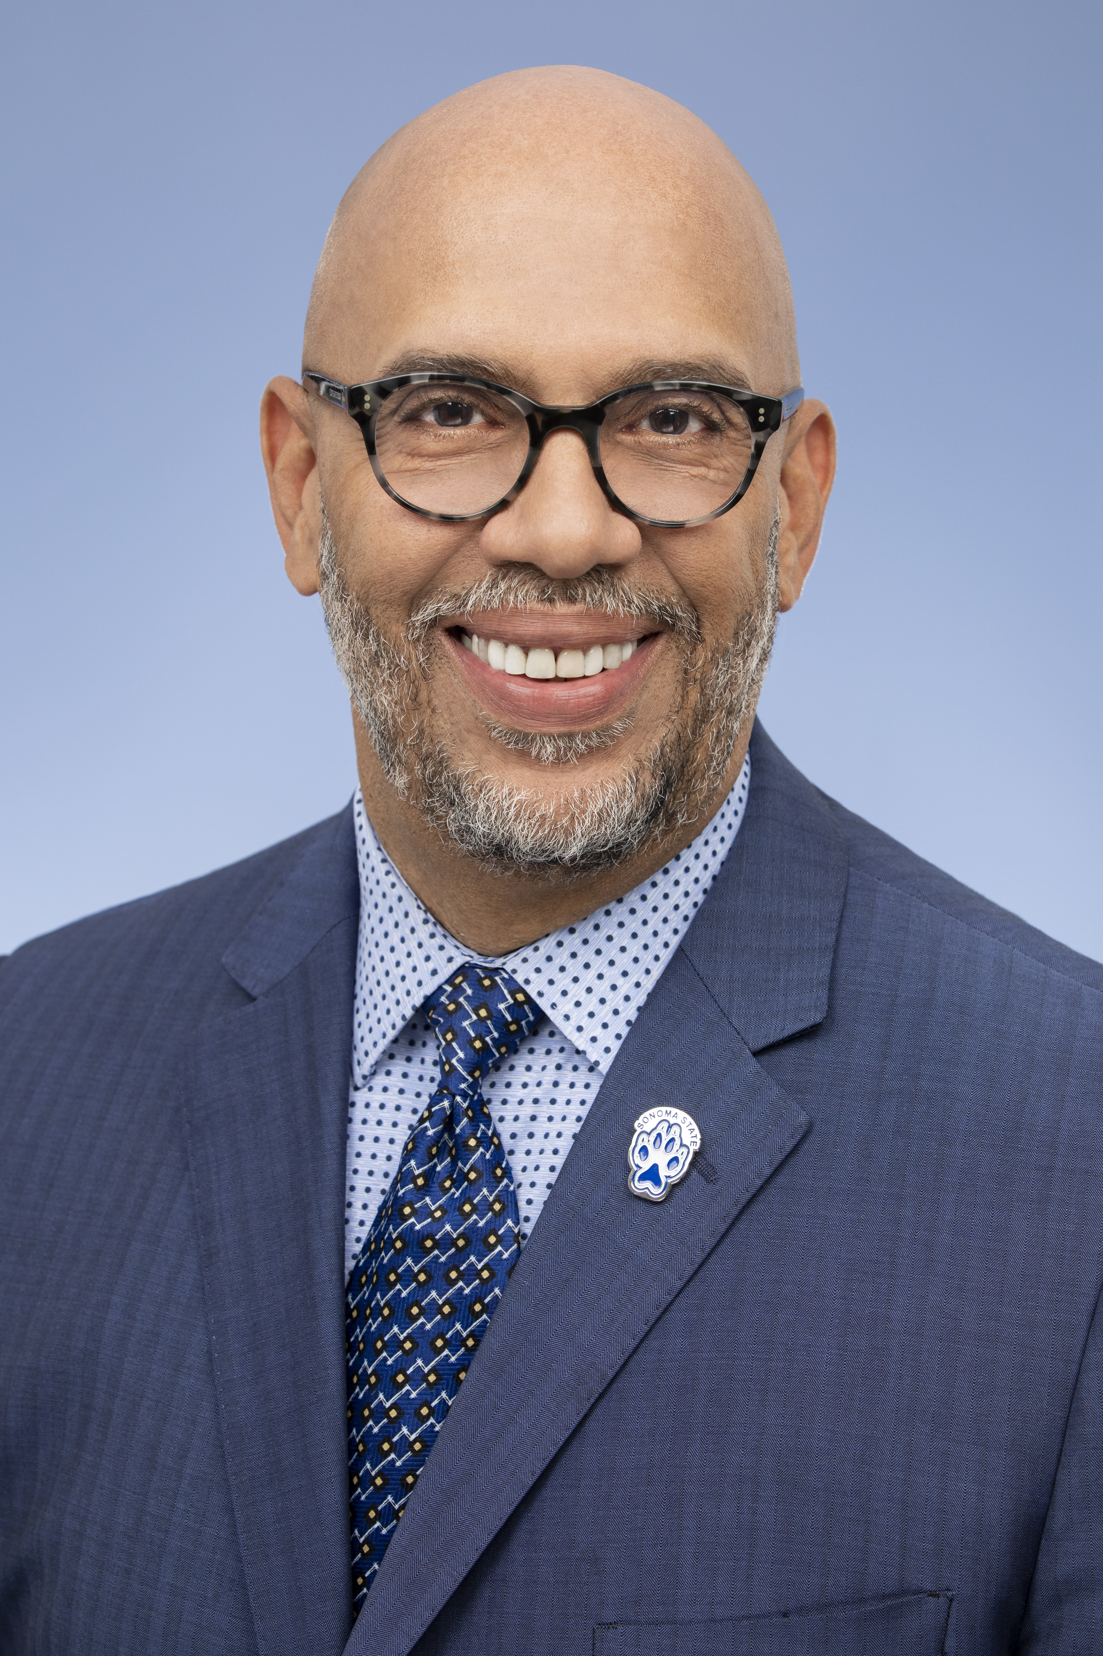
VICE PRESIDENT FOR STUDENT AFFAIRS
Birthday Shout Outs
Closing Remarks
The Office of the Vice President serves as the administrative foundation and central location for the co-curricular programs, areas, and services of Student Affairs.

Slide 28
Jordan Bartholdy
Tara Barr
Toni Boracchia
Marissa Chavez
Cynthia Foss
Maria Noelia Franzen
Jesus Garcia-Valdez
Christy Giambastiani
SEPTEMBER BIRTHDAYS

Slide 29
Audra Grady Verrier
Ryan Jasen Henne
Eric Jenne
Gerald L. Jones
Stacey Murray
Shannon Smith
Nicole Stein
Laura Williams
Jamie Zamjahn
SEPTEMBER BIRTHDAYS

Slide 30
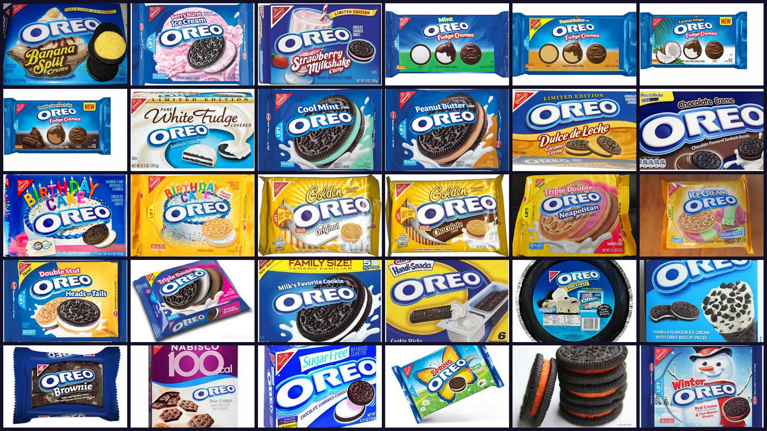
VICE PRESIDENT FOR STUDENT AFFAIRS
Closing Remarks
Check in with each other
Practice self care
Know that you are appreciated
Enjoy the Oreo Cookie tasting! (Thanks to Ryan Jasen Henne!)

Slide 31
DIVISION MEETINGS
FALL 2019
DATE | TIME | LOCATION
Tues. Sept. 24 | 10:00-11:30a | Ballroom B
Tues. Oct. 22 | 10:00-11:30a | Ballroom B
Tues. Nov. 19 | 10:00-11:30a | Ballroom B
Tues. Dec. 17 | 10:00-11:30a | Ballroom B

